Slide 1

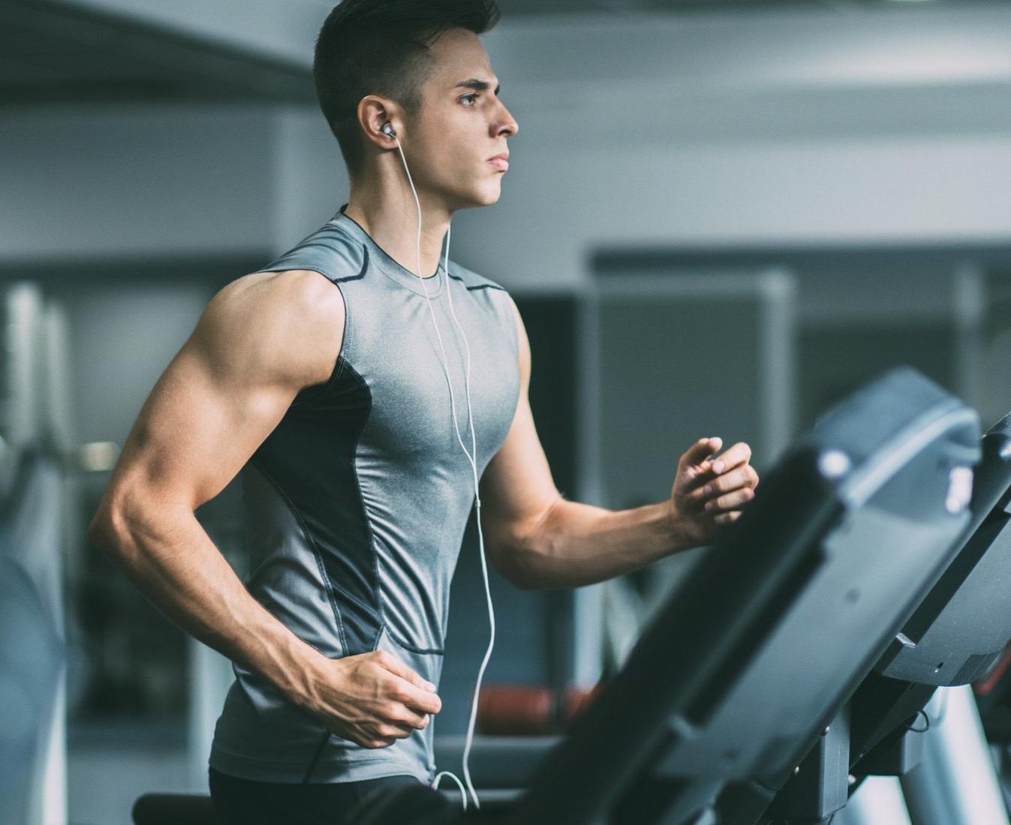
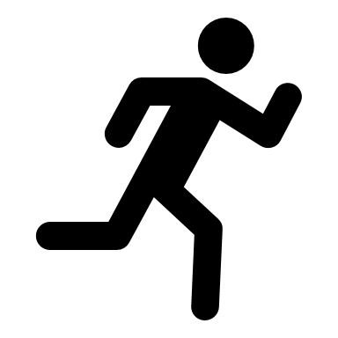

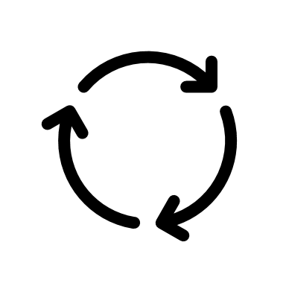
Bellabeat Fitness Data Analysis Presentation
File created on: 08/05/2023 4:34:18 AM

Slide 2
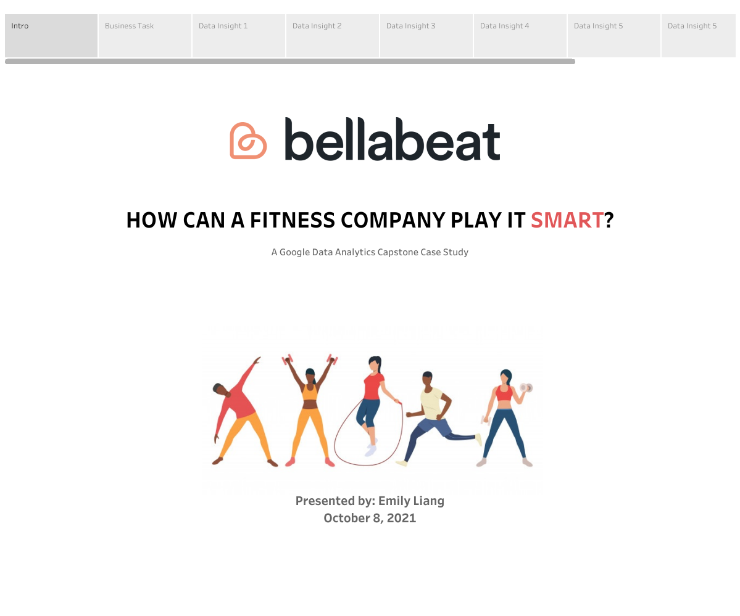
Presented by : Sachin Narasapur
May 08, 2023

Slide 3
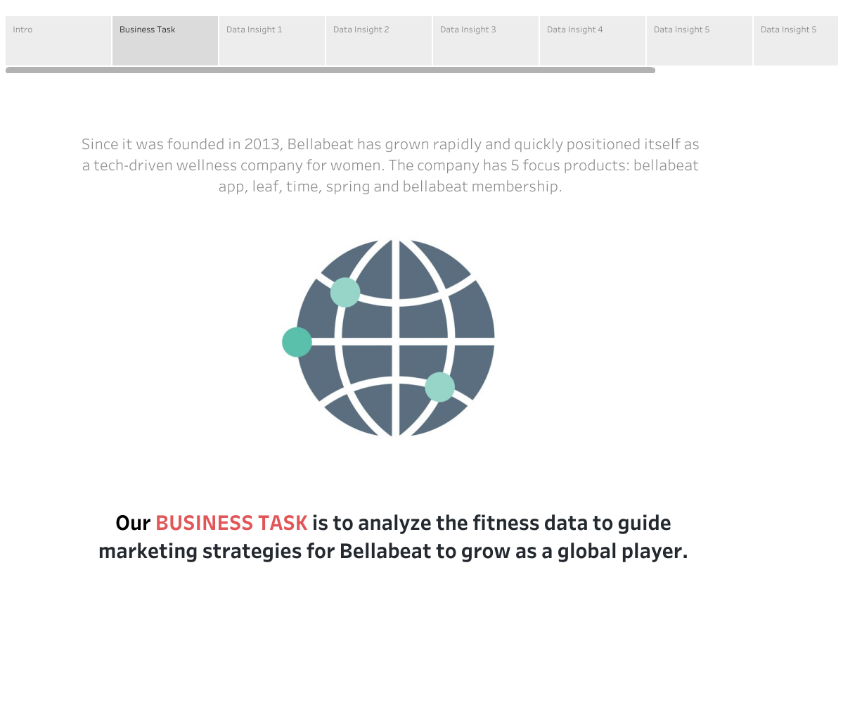

Slide 4
Approach to Solve This Case Study
1. Trends in smart device usage?
2. Trends apply to Bellabeat customers ?
3. Trends help influence Bellabeat marketing strategy?
1.Organize and format your data
2. Identify trends and relationships
3. Aggregating your data so it's useful and accessible
1.ASK
4.Analyze
1.Used public data that explores smart device
users daily habits.
2.FitBit Fitness Tracker Data , From Kaggle
3. Analysis of Tracked Data
1.Now we create data visualizations to clearly communicate your high-level insights and recommendations.
2.Barchat, Scatterplot, pie chart, Histogram
2.Prepare
5.Share
Data Cleaning process
1. finding duplicates in both rows and columns
2. Missing data,finding unique values etc.
3. solving the errors.
1.Answer to asked business questions
2. Recommendations
3.Conclusions and Deciision making
3.Process
6.Act

Slide 5
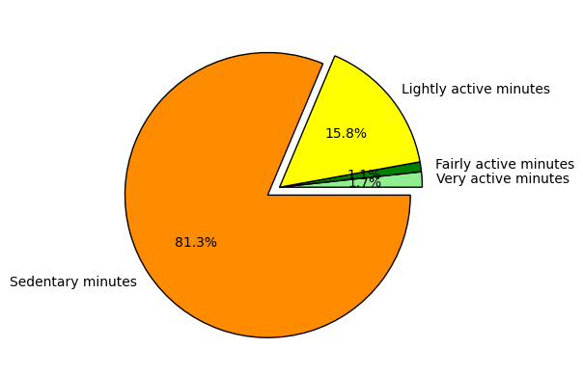
HOW ACTIVE TOTAL?
81.30% in SEDENTARY minutes
2.85% in fairly to very ACTIVE minutes
1.Sedentary minutes take the BIGGEST PERCENTAGE OF 81.3%. This is not good since Sedentary behaviour refers to activities that use very little energy while being awake.
These activities exposes the users to HEALTH RISKS.
2. Very active minutes are at 1.7% which means the users are NOT INVOLVING themselves in the required PHYSICAL ACTIVITIES to enhance the amount of calories burnt.

Slide 6
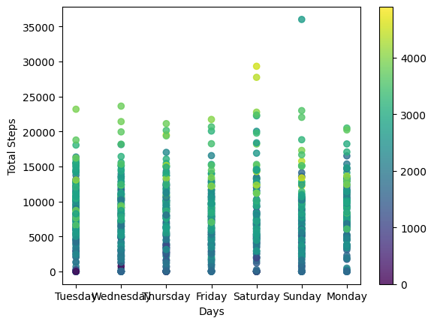
HOW DAILY ACTIVITY?
TOTAL 65K More-Steps taken on SATURDAY AND SUNDAY

Slide 7
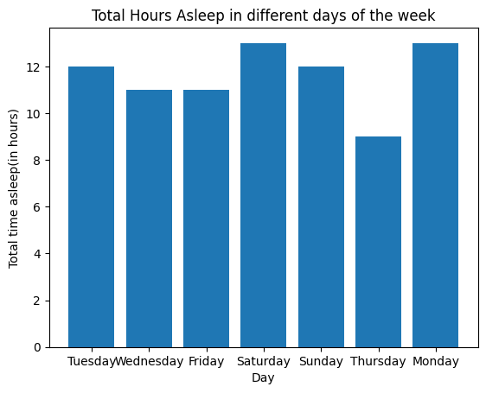
HOW ACTIVITY OF ASLEEP HOURS?
SATURDAY has the highest number of hours asleep.
All the World loves Saturday! As many as 90% of users sleep more time on Saturday morning, 30 minutes of sleep more than usual.

Slide 8
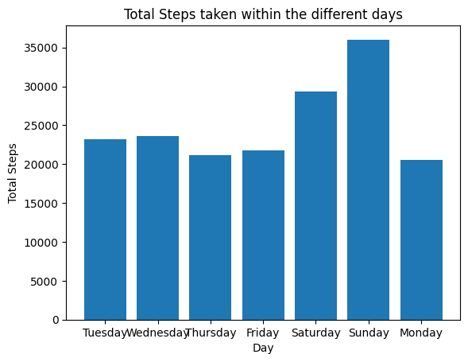
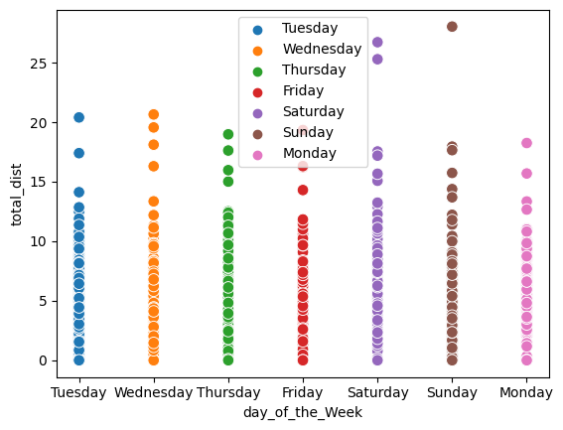
WHERE IS THE JUMP?
SUNDAY has the MOST DISTANCE covered while THURSDAY has the LOWEST.

Slide 9
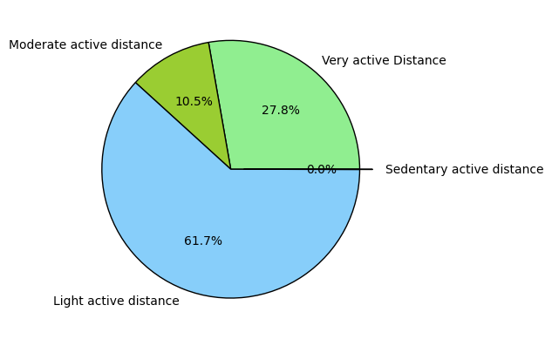
WHAT IS THE INDIVISUAL ACTIVE DISTANCE?
1. Light Active Distance takes the BIGGEST SLICE with 61.7% 2.According to sedentary active distances are LESS THAN 5,000 steps daily. It hold the LOWEST PERCENTAGE in the pie chart at 0.0% meaning participants achieve over 5,000 STEPS DAILY.

Slide 10
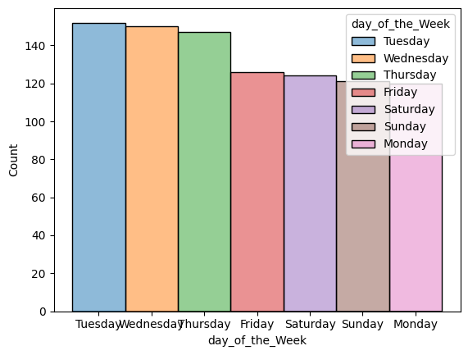
HOW'S THE USERS LOGIN ACTIVITY?
TUESDAY is the day which has the HIGHEST ACTIVITY while MONDAY has the LOWEST ACTIVITY.

Slide 11
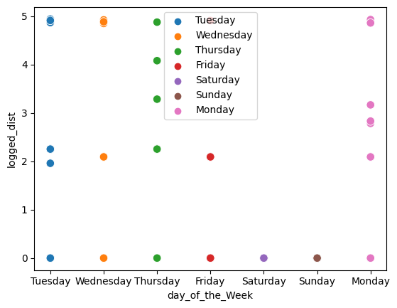
HOW'S THE USERS LOGIN ACTIVITY?
This shows that MOST users DO NOT LOG IN their smart devices when they go about their DAILY ACTIVITIES.

Slide 12
6. Act
What are some trends in smart device usage?
Most users (61.7%) achieve the light active distance. This means they involve themselves in Light intensity activities require the least amount of effort, compared to moderate and vigorous activities which is not beneficial to their health.
Tuesday is the day which users are MOSTLEY ACTIVE.
Sedentary minutes take the BIGGEST PERCENTAGE of 81.3%. This is not good since Sedentary behaviour refers to activities that use very little energy while being awake. Examples of sedentary behaviour include:
sitting for long periods
watching television
riding in a bus or car
playing passive video games
playing on the computer and
sitting in a car seat or stroller.
these sedentary activities exposes the users to a lot of health risks.
Monday and Saturday are the days with the most hours asleep.
The average steps covered by most users is 7637 as compared to the recommended 10,000.
Users are more active on weekdays than on the weekends.
According to the logged activities distance, most users do not log in the app while working out.

Slide 13
How could these trends apply to Bellabeat customers?
These companies both FOCUS ON women health, the trends can help bellabeat make more informed decisions for their customers. The trends can help bellabeat customers change their routines and be WELL iINFORMED on how to use the bellabeat products for their HEALTH BENEFITS.
How could these trends help influence Bellabeat marketing strategy?
Bellabeat can use this trend to find the weaknesses that the users face regarding the exercising, FIND SOLUTIONS and EDUCATE THEM on the importance of exercising. To educate the users more on how the different bellabeat products work since most of them seem not to know how they work.

Slide 14
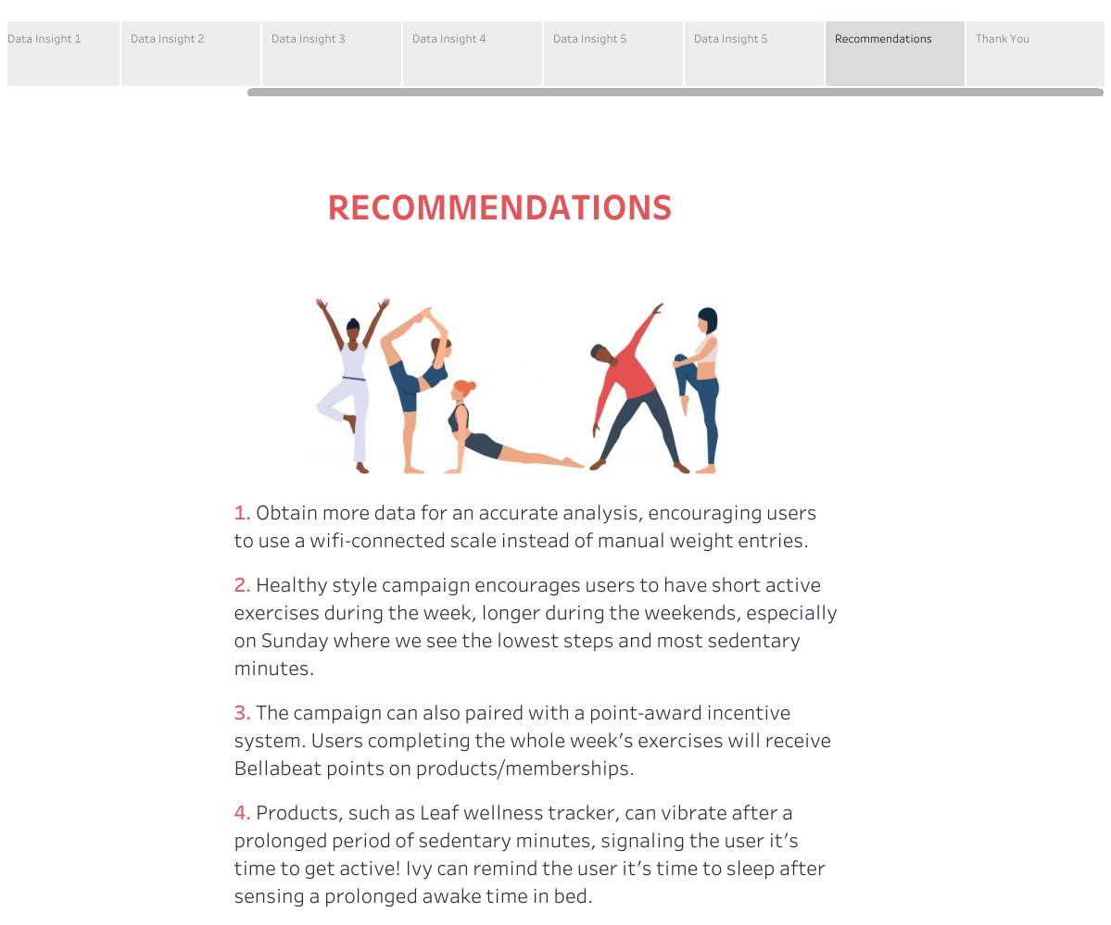

Slide 15
QUESTIONS?
EMAIL: sachinreddy429@gmail.com
DATA SOURCE: Kaggle
OTHERS PROJECTS: https://github.com/sachinreddygithub

